Slide 1
QUAIL
HATCHING
GUIDE
Brought to you by:

Slide 2
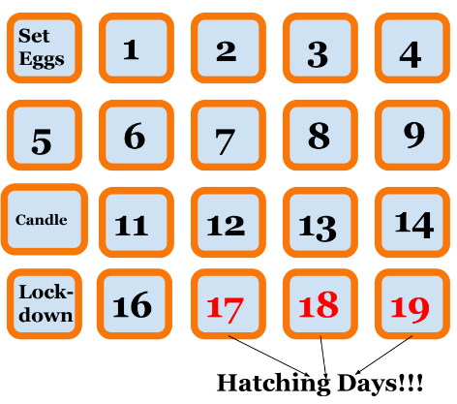
Hatching Calendar
Key Dates:
Day 0 - Set eggs in incubator
Day 10 - Candle eggs
Day 15 - Lockdown (remove turner and raise humidity)
Day 17 - Look for pips and the first chick
Day 18 - Most chicks should hatch
Day 19 - Could still be a late arrival
Day 20 - Unplug incubator

Slide 3
Setting Up Your Incubator
Run your incubator for several hours before putting the eggs in to verify:
Temperature has leveled off at 99.5 degrees.
Humidity has settled between 40% and 50%.
Ensure egg turner is working. If no automatic egg turner, hand turn eggs AT LEAST four times a day.
Temperature and humidity gauges on incubators are notoriously wrong. We recommend putting a digital hygrometer in the incubator as a double check. Amazon sells mini-hygrometers for about $3 each.

Slide 4
Candling and Lockdown
On or around day 10, you can candle the eggs to see how many are fertile and developing. This is optional but by removing the infertile eggs, there will be more room in the incubator for the others to hatch.
Do the following on Day 15 for “lockdown”:
Remove automatic turner.
Increase humidity to between 60% and 75%.
Keep temperature at 99.5 degrees.
We recommend putting a mesh shelf liner down under the eggs. This allows the air to circulate and gives the chicks better footing in the incubator to help prevent splay leg issues.

Slide 5
Hatching and Moving Chicks to Brooder
Chicks could begin to pip and hatch as early as day 16 but most will hatch on days 17 and 18. There could also be some stragglers on day 19.
After the first chick hatches, wait between 36 and 48 hours before opening incubator to remove the first batch of chicks. This can be difficult because they will be chirping and racing around like they want out now!
The reason for waiting is to help prevent other chicks from getting “shrink-wrapped”. The sudden drop in humidity when opening an incubator causes the egg membrane to constrict and can make it difficult for chicks in the process of hatching to get out of their shells.
Have the brooder setup and warm before moving chicks. There should be somewhere in the brooder that’s about 95 degrees.
Any eggs that hatch after the first batch of chicks have been moved to the brooder can be taken out of the incubator once they’re dry and fluffy. Just be sure to look if there are any eggs in the process of hatching. If there are, wait for those chicks to hatch and dry as well.

Slide 6
Quail Chick Tips
Here are a few tips for newly hatched quail chicks:
Use warm water in the waterer. Cold water can shock a new chick.
Chicks can easily drown themselves so use pebbles in a water dish or a waterer that doesn’t allow them to submerge their head.
Grind up some game bird starter in a food processor to use for the first couple days. This isn’t required but will make it easier for them to find food they can handle and helps limit feed waste.
Put down paper towels or puppy pads for the first few days before moving to pine shavings for bedding.
Wash hands thoroughly before handling chicks (especially children).

Slide 7
Congratulations!
Congratulations on hatching your new quail chicks!
If you have any questions, feel free to call, text or email.
Shane Smeby, Owner
Crow River Quail Farm
(612) 590-6562 (call or text)
crowriverquail@gmail.com
www.crowriverquail.com

